Slide 1
QR CODE GENERATION FOR FOOD ORDER
BATCH MEMBERS:
1.P.SHIVASHREE(IT2044)
2.R.SHRUTHI(IT2046)
3.S.R.VARSHINI PRIYA(IT2055)
BATCH NO:19
GUIDE NAME:
Dr. S. MANIKANDAN

Slide 2
OBJECTIVE OF THE PROJECT:
Python is a programming language that provides different packages that allow us to generate a QR code.
Designing a QRcode we have to install python QRcode package with the help of pip installer.
After generating QRcode we have to implement the purpose for creation QRcode.
Our AIM is to design a QRcode for login purpose by creating a webpage.

Slide 3
ABSTRACT:
QR i.e. "Quick Response" code is a 2D matrix code that is designed by keeping two points under consideration, i.e. it must store large amount of data as compared to 1D barcodes and it must be decoded at high speed using any handheld device like phones.
• QR code provides high data storage capacity, fast scanning, omnidirectional readability, and many other advantages including, error-correction (so that damaged code can also be read successfully) and different type of versions.
• Different varieties of QR code symbols like logo QR code, encrypted QR code, iQR Code are also available so that user can choose among them according to their need.

Slide 4
Now these days, a QR code is applied in different application streams related to marketing, security, academics etc. and gain popularity
The popularity of QR code grows rapidly with the growth of smartphone users and thus the QR code is rapidly arriving at high levels of acceptance worldwide.
While QR Codes and Barcodes are similar in practice, QR Codes contain more information because they have the ability to hold information both horizontally and vertically

Slide 5
HARDWARE AND SOFWARE REQUIREMENTS:
QRCODE SCANNER,
PI PNG,
PILLOW,
PIZ BAR,
WEBPAGE,
HTML

Slide 6
Modules of Food Ordering System:
Login Module: Used for managing the login details.
Users Module: Used for managing the users of the system
Food Item Management Module: Used for managing the Food Item details.
Management Module: Used for managing the information and details of the Category.
Customer Module: Used for managing the Customer details.
Order Module: Used for managing the Order informations.
Confirm Order Module : Used for managing the details of Confirm Order.
Payment Module: Used for managing the details of Payment Category

Slide 7
Existing System of Food Ordering System:
In the present scenario, people have to physically visit the hotels or restaurants for eating food and have to make payments through cash mode most of the time due to unawareness of advanced technologies at certain places. In this method time as well as physical work is required, among which time is something that no one has in ample amount.
The traditional food ordering procedure is not efficient enough for hotels and restaurants, as they have to deal with the crowd, in their restaurant. The old methods can be classified into categories which are paper grounded and verbal grounded. For paper-based work, the waiter comes and pens down foods that customers order and pass the food list containing paper to the chefs or cooks in the kitchen for further process.
Also, from the owner’s point of view maintaining data records and the accounts in the physical file are cumbersome and tedious work to do. And also, it is full of risk as anyone can access it and modify the data.

Slide 8
Proposed System of Food Ordering System:
This system is a bunch of benefits from various points of view. This online application enables the end-users to register to the system online, select the food items of their choice from the menu list, and order food online. Also, the payment can be made through online mode or at the time of home delivery depending upon the customer’s choice and convenience.
The selection made by the customers will be available to the hotel reception or to the person handling the work assignment. Now this same person will assign the orders to the specialist chef to be completed within a fixed duration of time. As soon as the chef prepares the food, the later person forwards the parcels to the delivery persons assigned with the location and customer identity of the customer along with the bill status.

Slide 9
With this application, the workload of the water in the hotel Sare reduced, or in some situations, their work is abolished. One of the various benefits of this is system is that if there is a rush or a huge crowd present in the restaurant then in that case sometimes unavailability of tables cut downs the restaurant’s customer.
Also, there will be chances that the waiters are unavailable as they are busy handling others, so the customer can directly order the food to the chef online by using this application, by checking the seat availability in the restaurant. This system allows the staff to serve customers within less time as compared to the manual system.

Slide 10
System Design of Food Ordering System
In this phase, a logical system is built which fulfils the given requirements. Design phase of software development deals with transforming the clients 's requirements into a logically working system. Normally, design is performed in the following in the following two steps:
1. Primary Design Phase
2. Secondary Design Phase

Slide 11
1. Primary Design Phase:
In this phase, the system is designed at block level. The blocks are created on the basis of analysis done in the problem identification phase. Different blocks are created for different functions emphasis is put on minimising the information flow between blocks. Thus, all activities which require more interactions are kept in one block.
2. Secondary Design Phase:
In the secondary phase the detailed design of every block is performed.

Slide 12
PROBLEM DEFINITION
The People have to be present condition in taken food from Hotel that means People had to compulsion of goes to Hotel.
Now the moment the food ordering could be called the response of the Internet to the desire for delivery food.
It is a growing trend especially in urban areas and on college campuses that allows people to order from restaurants featuring interactive menus, by use of their Internet connection.

Slide 13
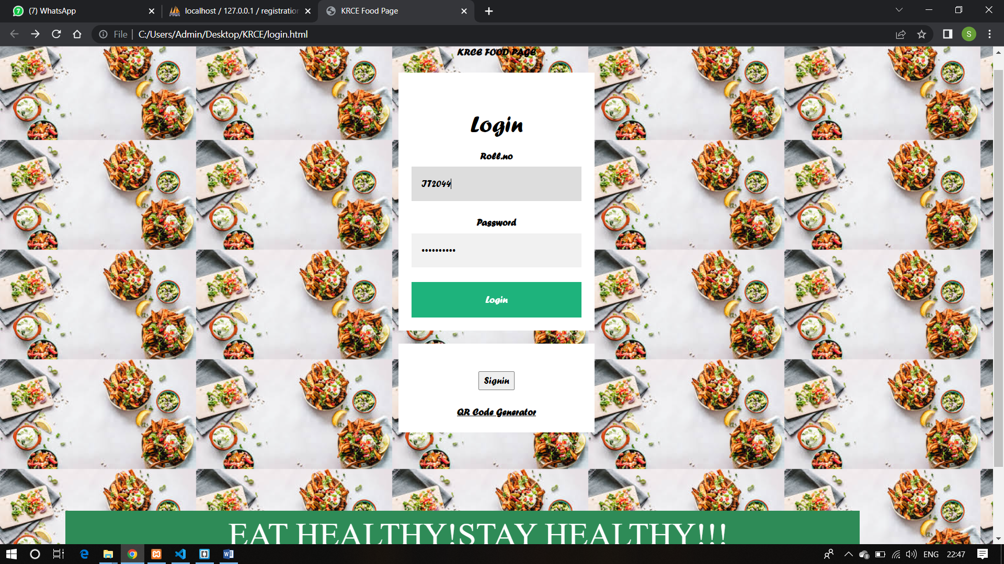
LOGIN PAGE

Slide 14
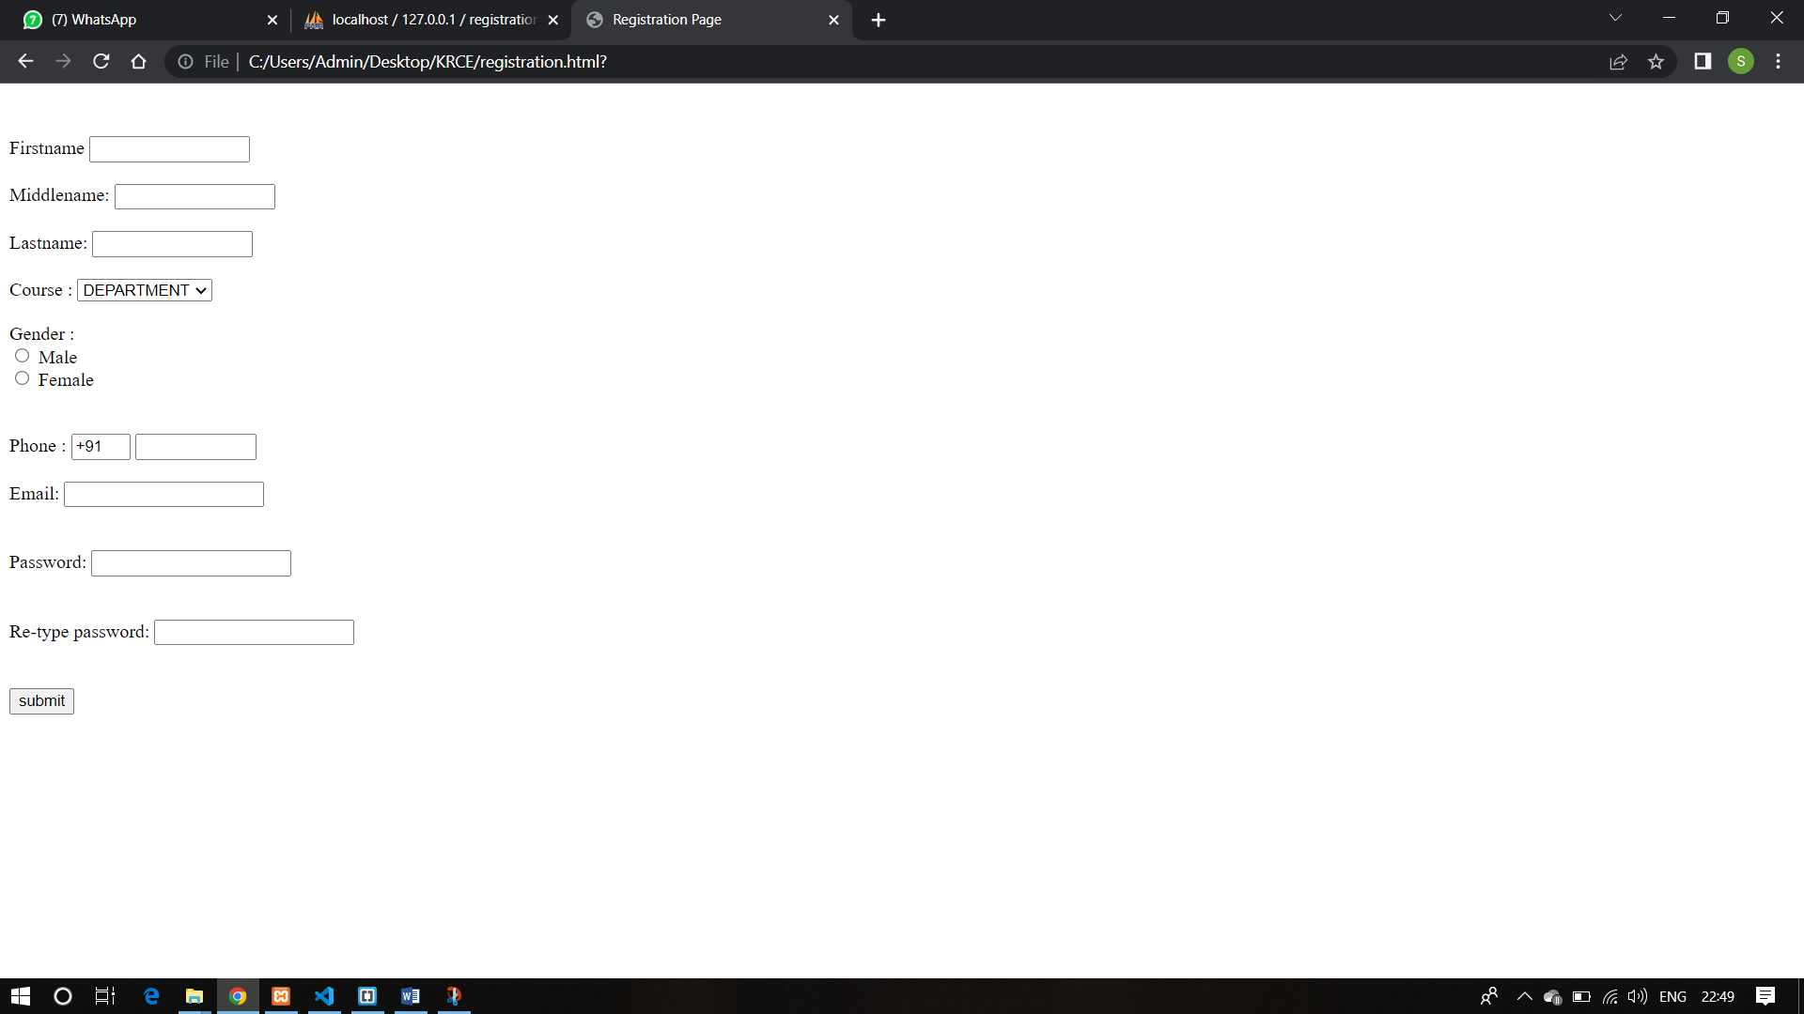
REGISTRATION PAGE

Slide 15
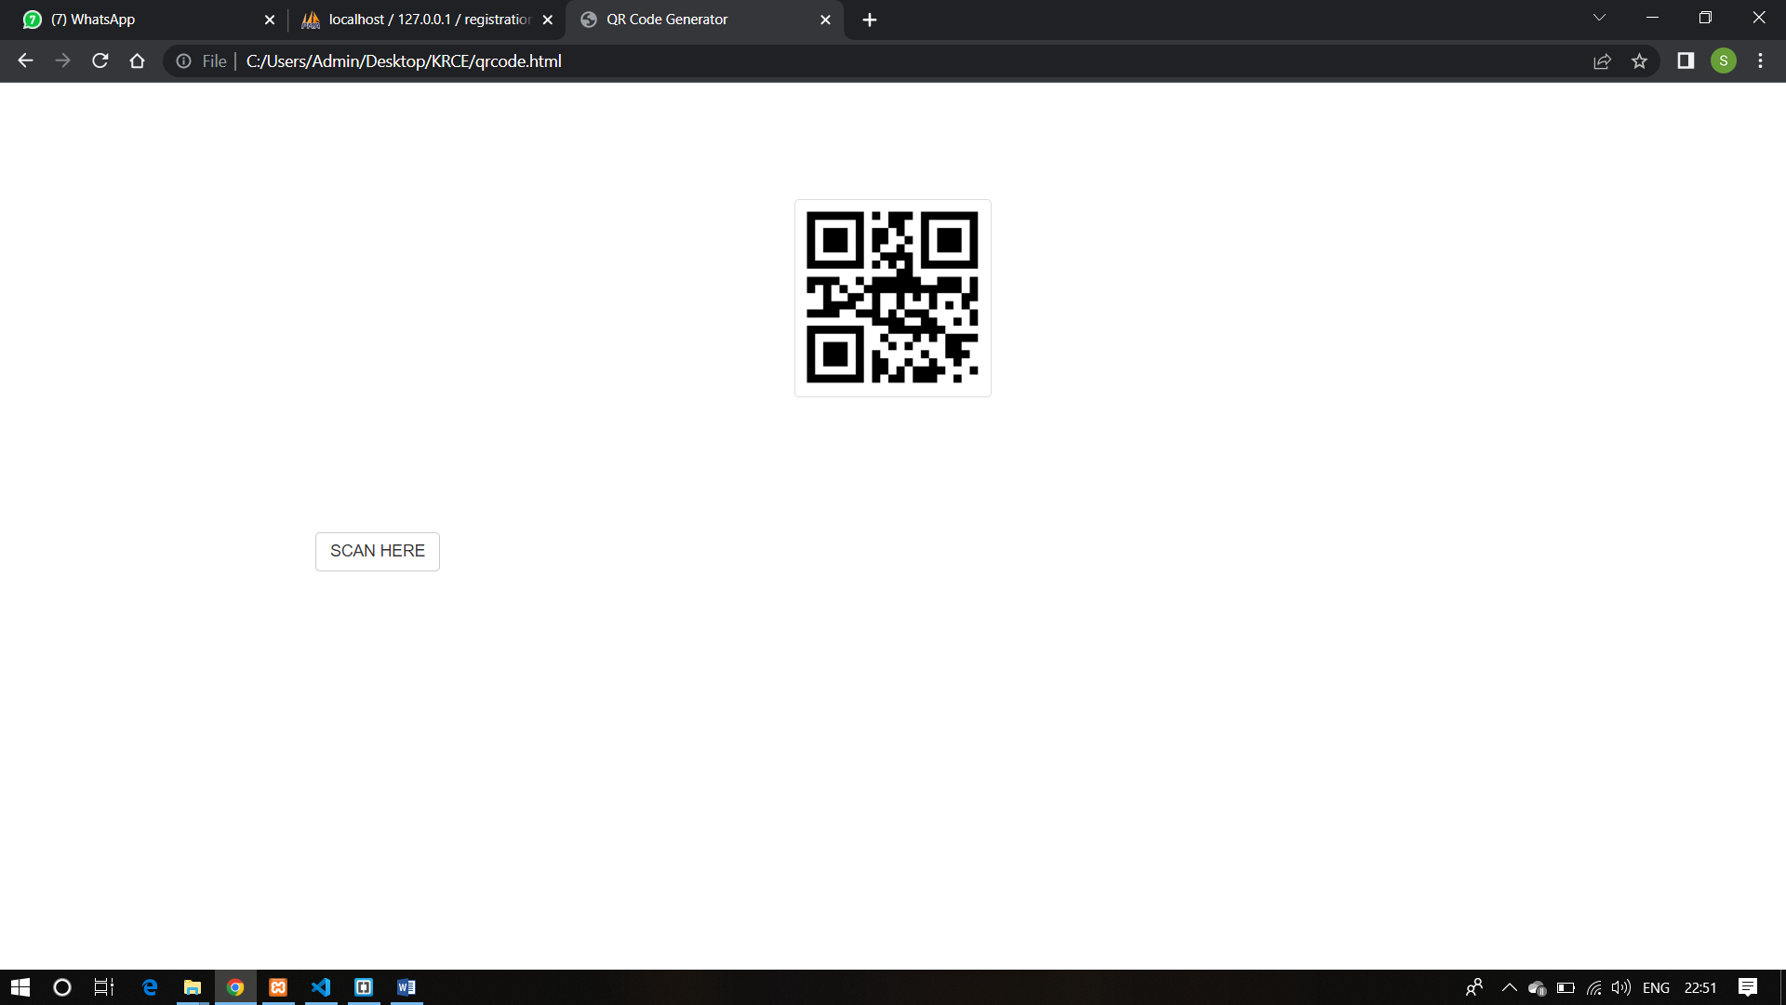
QR CODE GENERATOR

Slide 16
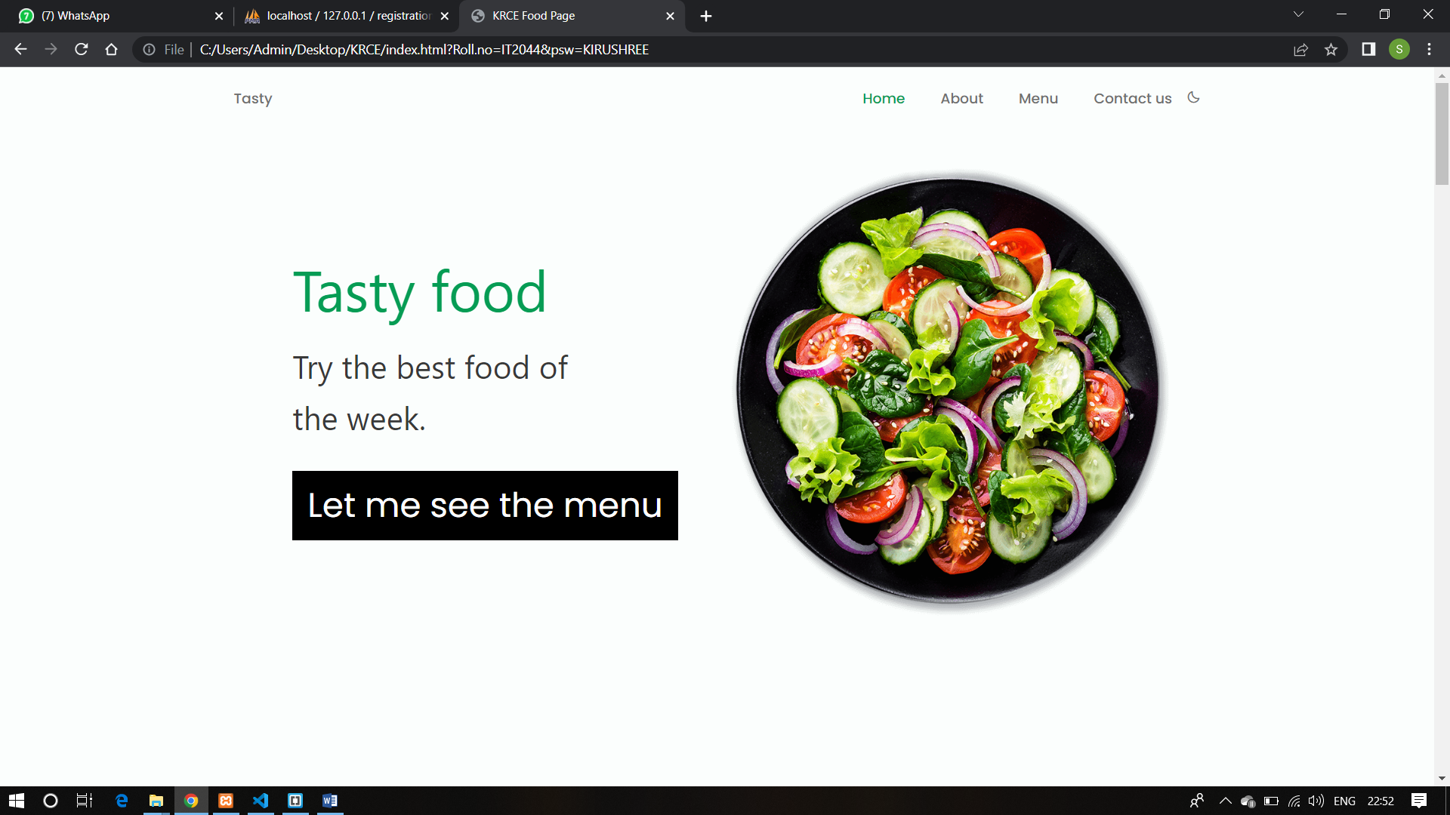
HOME PAGE

Slide 17
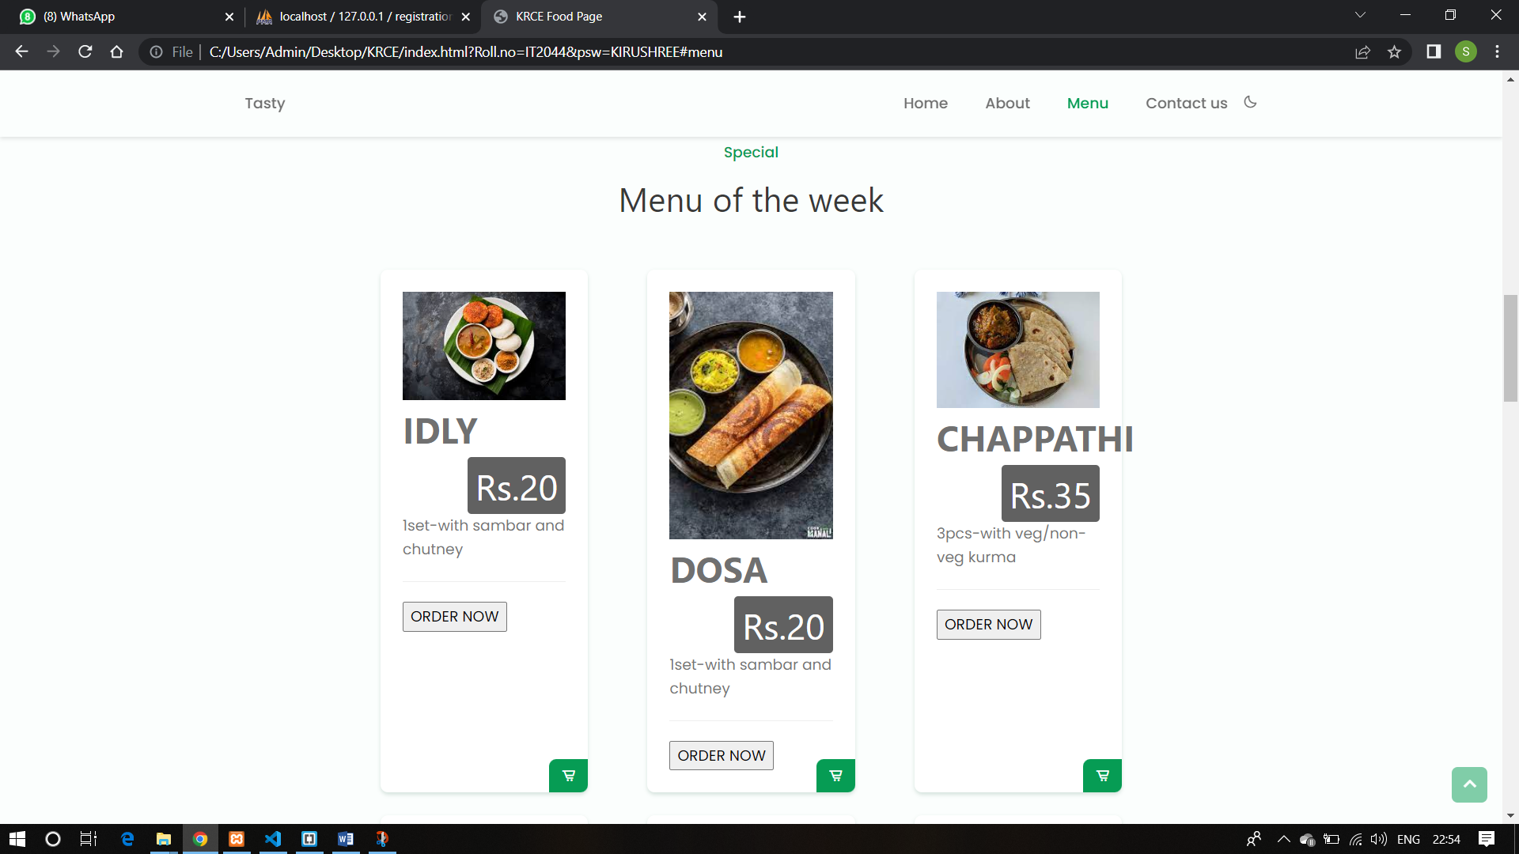
MENU PAGE : 1

Slide 18
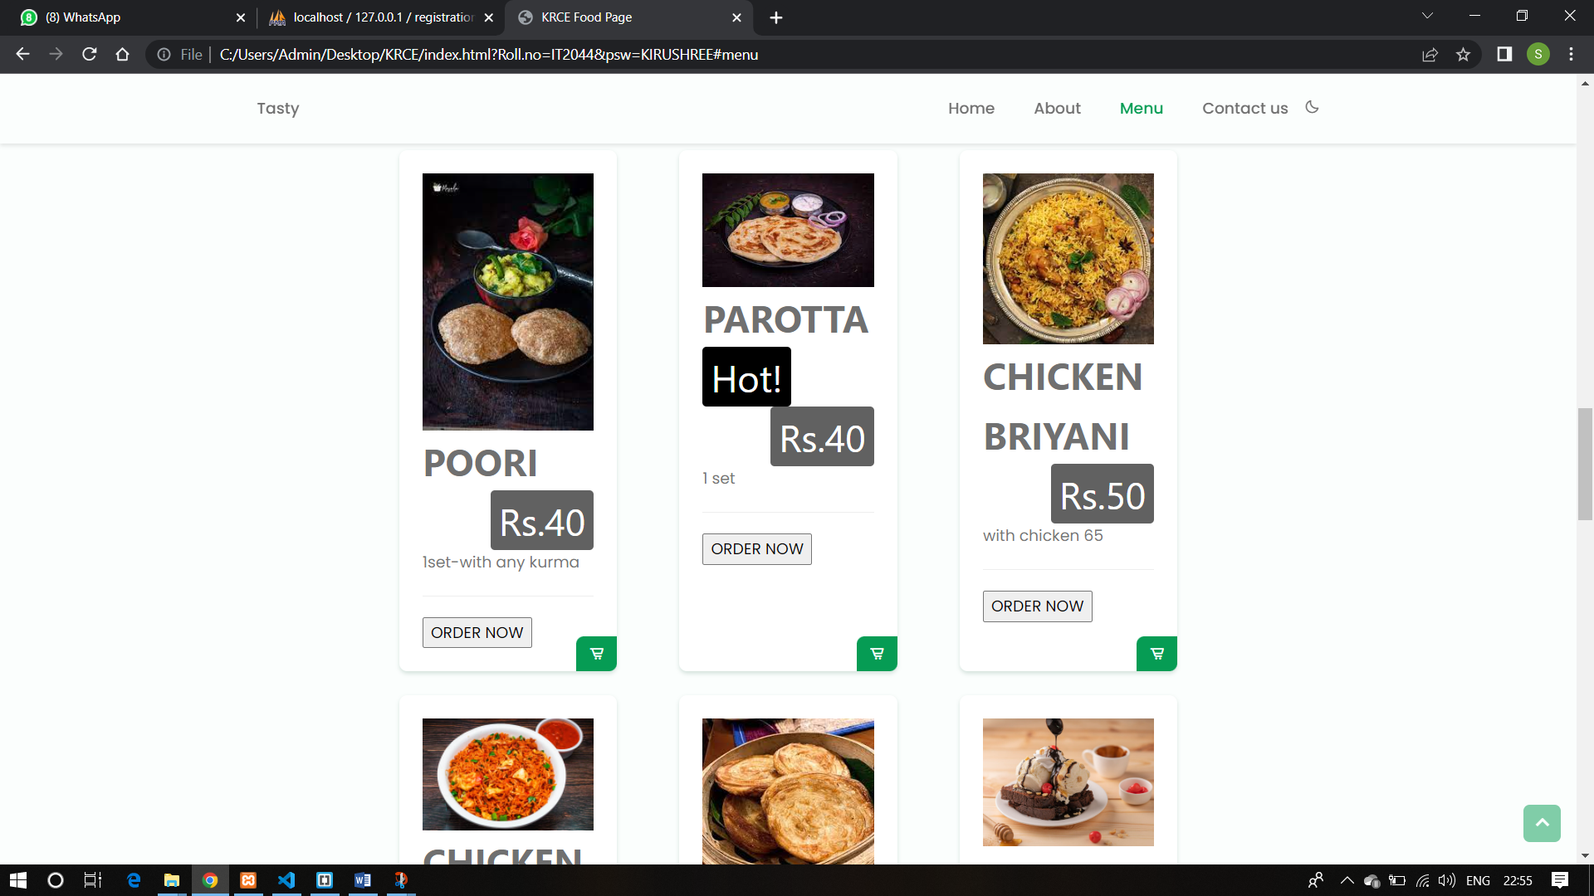
MENU PAGE : 2

Slide 19
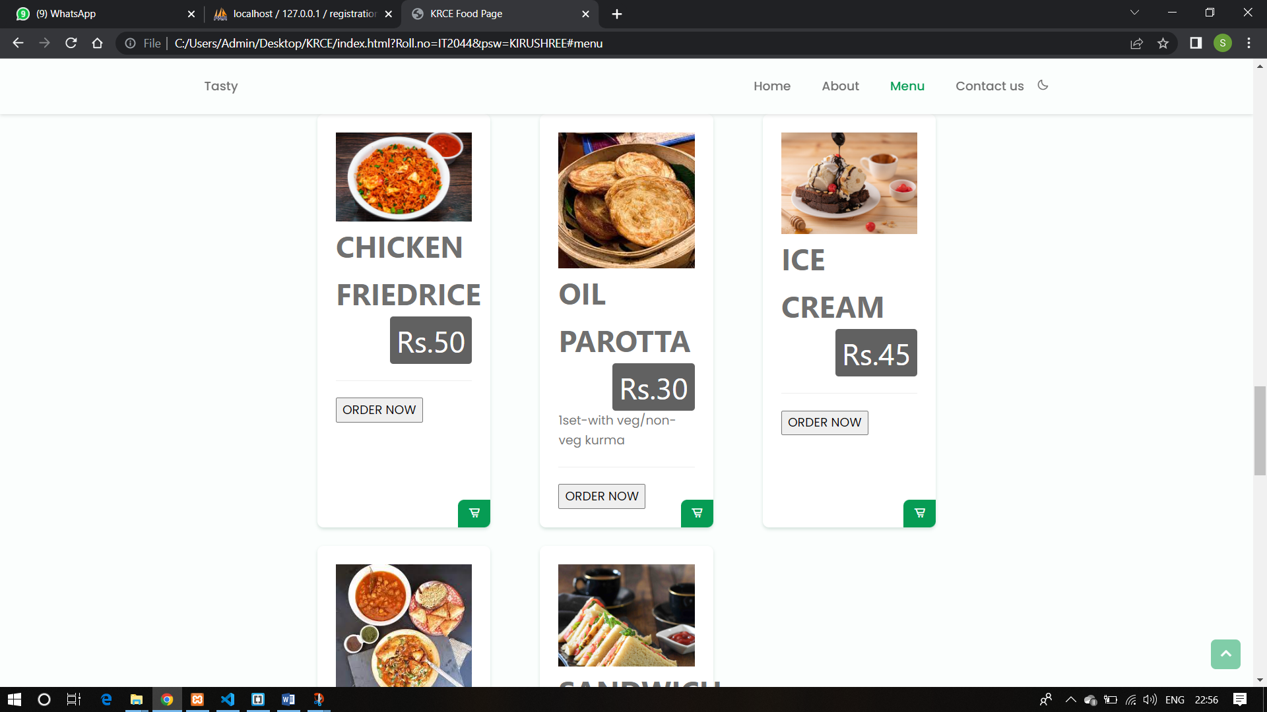
MENU PAGE : 3

Slide 20
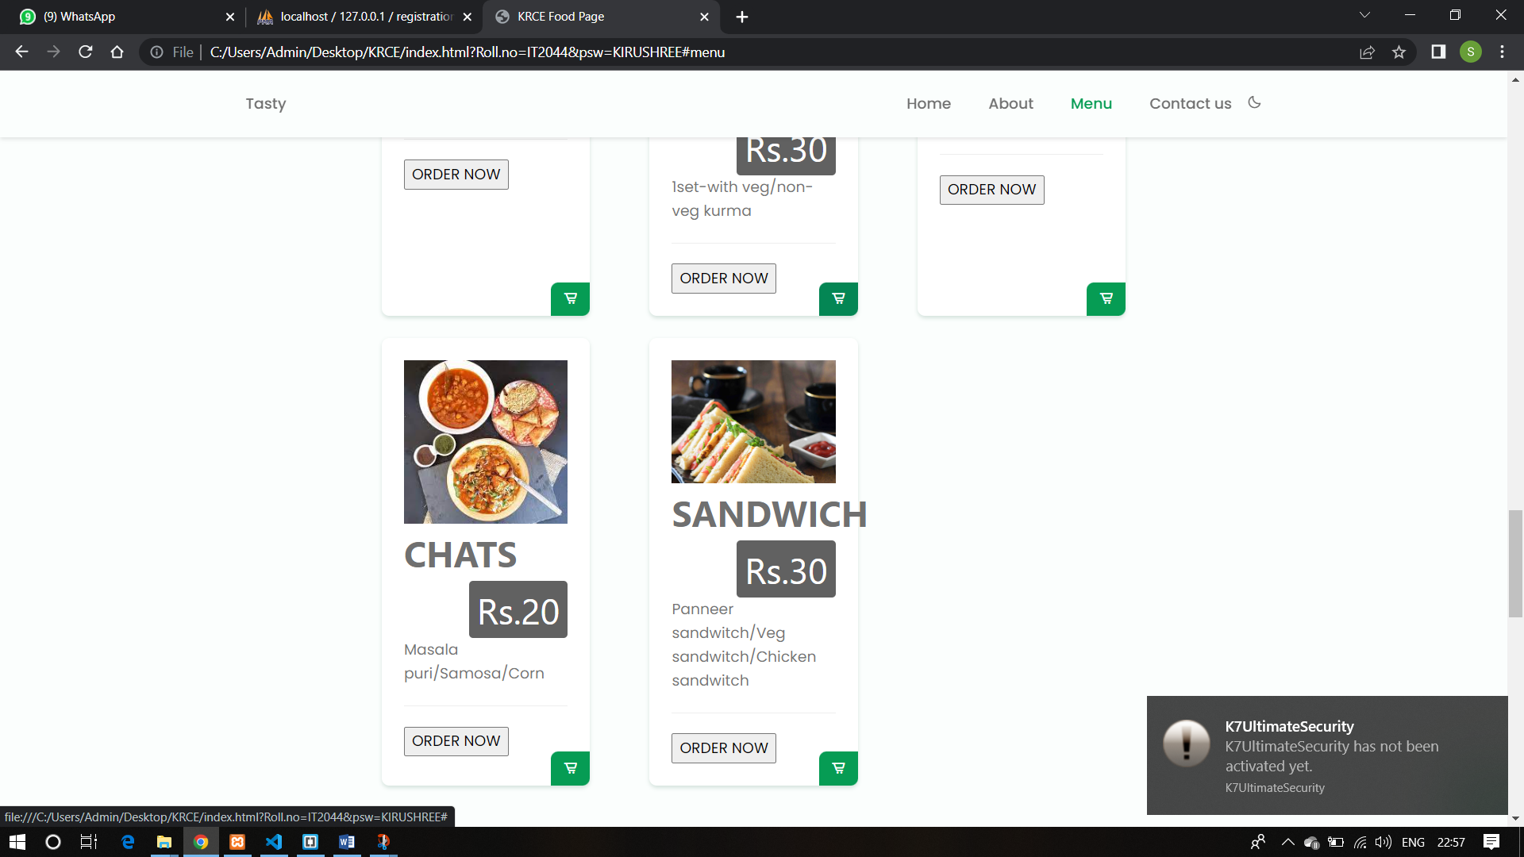
MENU PAGE : 4

Slide 21
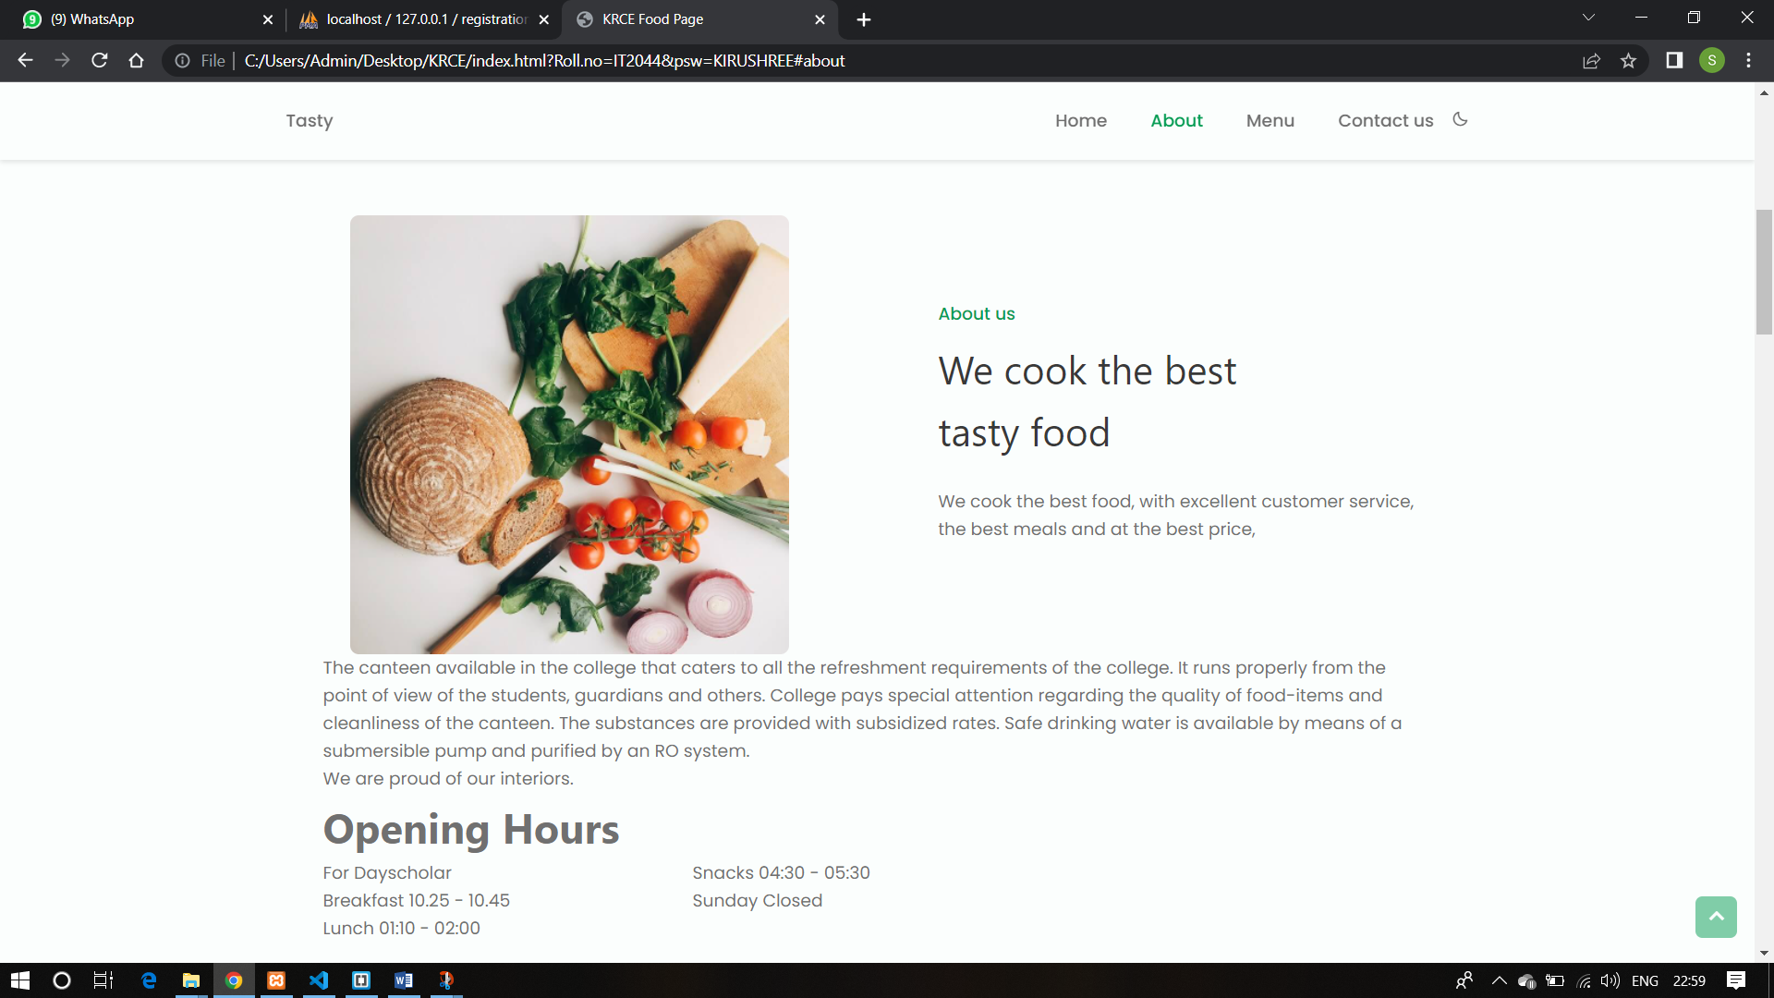
ABOUT PAGE

Slide 22
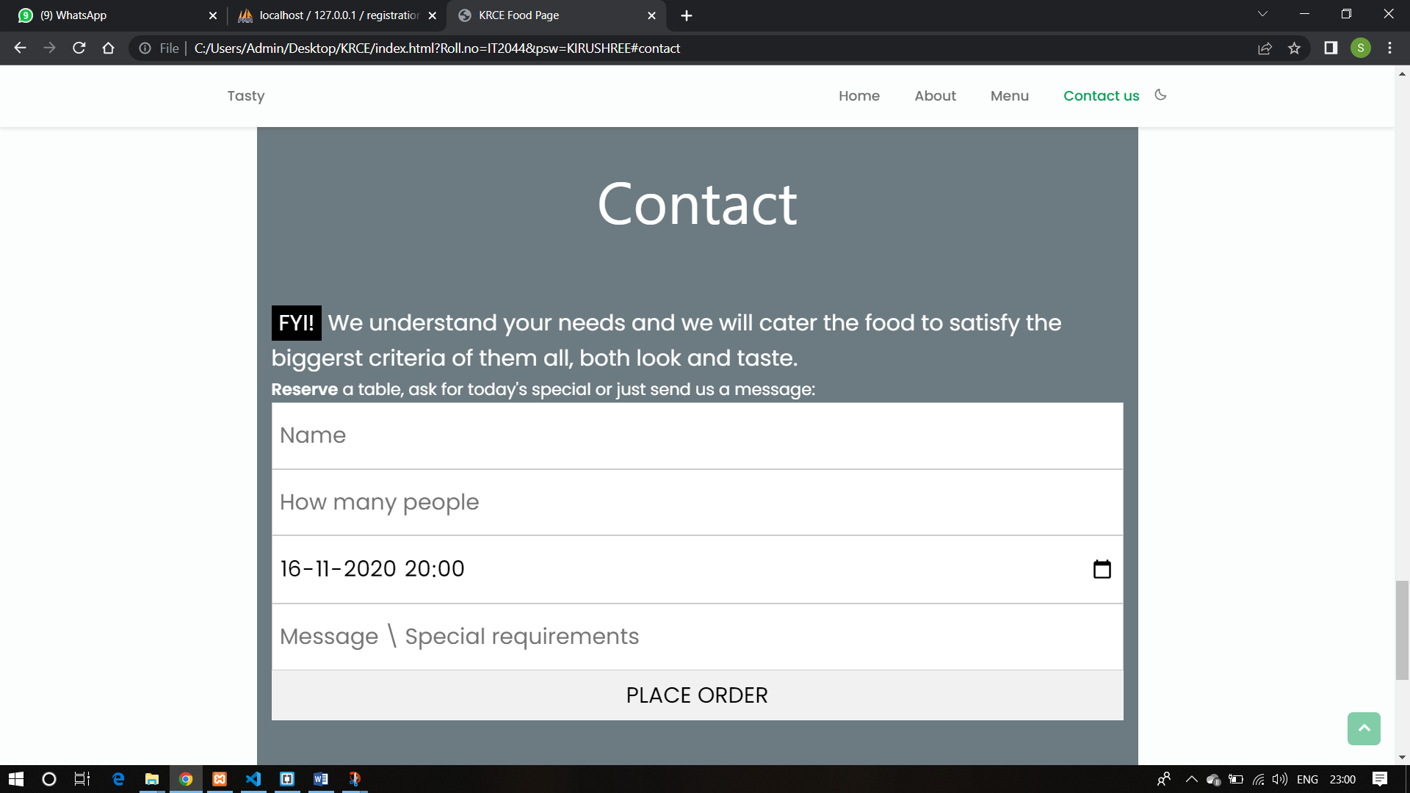
CONTACT PAGE

